Slide 1
Step to be Happier

Slide 2
Introductions
Name: Zhaohan Tan
Yixuan Wang
Zhihao Wang
We hope that student can reflect and understand the steps of happiness and regain it.

Slide 3
01
Introduction: Factors of Unhappiness
What We're Doing Today
02
Internal Regulation - Changes in the Body
03
Internal Regulation -- Changes in Mood
(Step to be Happier)
04
External Regulation - Change of Environment

Slide 4
Introduction: Factors of Unhappiness
https://www.youtube.com/watch?v=rCLWc2--TKk

Slide 5
Internal Regulation - Changes in the Body
Stick to daily outdoor exercise and enjoy the fresh air.
Adequate daily intake of nutrients.

Slide 6
·Learn to self-reference. For example, you can stand in front of a mirror, look yourself in the eye and sincerely say: "I can; it's better than last time; I'm looking forward to ......".
Internal Regulation -- Changes in Mood

Slide 7
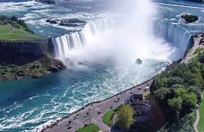
External Regulation - Change of Environment
Give yourself regular vacations and set aside enough time to travel to your favorite places.

Slide 8
Questions or Comments
Post class evaluation: https://docs.google.com/forms/d/1YsGLftkywar_ImXFAopnO-k2fm6F_o_Wu-YuXFiF6AY/edit

Slide 9
THANKS FOR WATCHING

